Slide 1

Week 2 Lesson 1 Academic Vocabulary and Style
Fall 2023
Sarbinaz Seytniyazova

Slide 2

Agenda
Review
Lead-in
Types of vocabulary
Academic style
Practice

Slide 3
Review
What methods of note-taking do you know?
What is effective reading and efficient reading?
What is analysis? What is synthesis?
Any homework? Let’s check!

Slide 4

Lead-in
How do you usually learn new words?
How many words do you usually learn?
How do you identify academic vocabulary?
How is it different from everyday words?
What is special about academic vocabulary?

Slide 5
Academic vocabulary
General
Academic
Technical

Slide 6
General academic vocabulary
Vocabulary that occurs frequently in all kinds of texts and everyday language
Consider these examples, all of which contain words we use daily, but all of which are acceptable in academic speech or writing:
The aim of this report is to... [language for reports]
What I want to talk about today is... [language for presentations]
There are several possible reasons for this, for example... [giving reasons, giving examples]
In comparison, the control group... [comparing]

Slide 7

Many words in academic English are the same as everyday vocabulary, but they are often also used with a slightly different meaning, which may be specialised
Discipline
Everyday use: Standards of discipline in schools have declined
Meaning: ability to control oneself or other people
Academic use: Nanotechnology is a relatively new discipline.
Meaning: area of study
Underline
Everyday use: Underline your family name on the form.
Meaning: draw a line under it
Academic use: The research underlines the importance of international trade agreements.
Meaning: gives emphasis to

Slide 8
Spoken English is more informal than academic English. It uses phrases like 'like' and things like that.
Acid rain is a bad thing for all of us.
These examples contain several words and phrases which would not be considered good academic style, for example like (to give examples), thing, and bad.

Slide 9

Academic vocabulary
Words that are used in academic dialogue and text. Specifically, it refers to words that are not common in informal conversations and writing.

Slide 10
Academic Word-list (AWL)
Abandon
Meaning: to leave a place, thing, or person, usually for ever
Anticipate
Meaning: to imagine or expect that something will happen

Slide 11

Technical (specific) vocabulary
Terminology or jargon, technical terms are a special type of vocabulary used to explain concepts specific to one particular area.

Slide 12
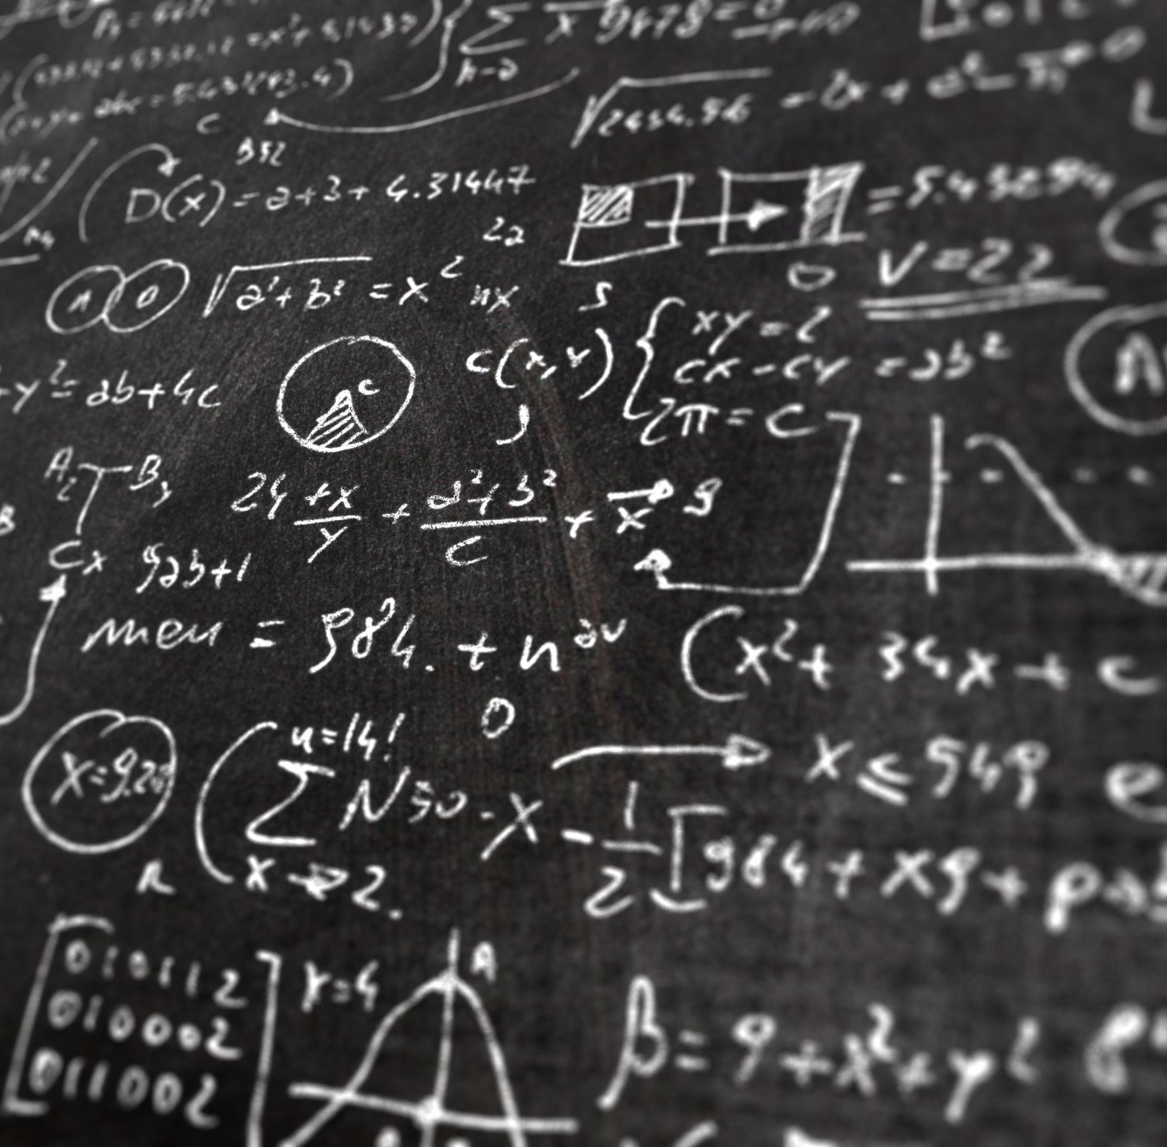
Technical, domain-specific or subject-specific words.
education
business
science & technology
politics
law
music
mathematics
environmental science
photosynthesis (for biology), inertia (for physics), externalities (for economics)

Slide 13

Nominalisation (noun phrases)
The process of changing verbs or adjectives to nouns
Why use nominalisation?
Grammatical process develops complex grammar noun-phrase structures.
It helps achieve a higher degree of abstraction and technicality.
It is a typical feature of academic writing.

Slide 14
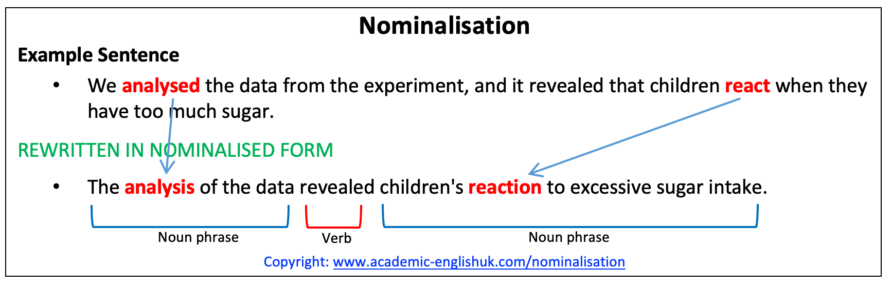

Slide 15
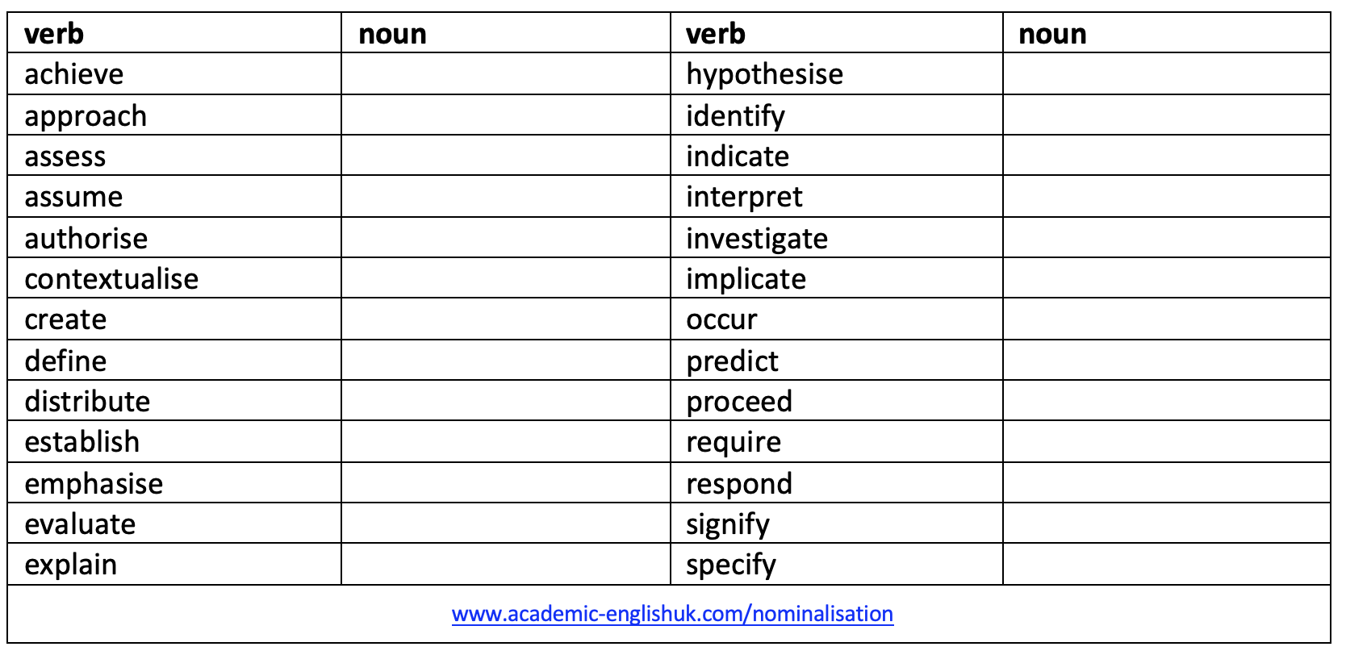

Slide 16
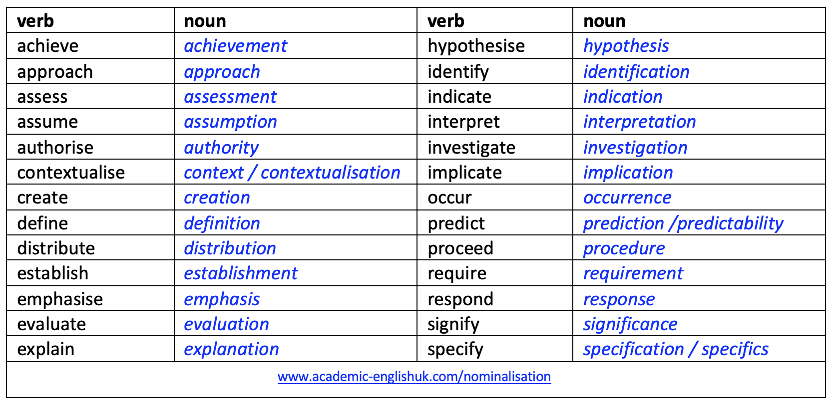

Slide 17

What is academic style in English?

Slide 18
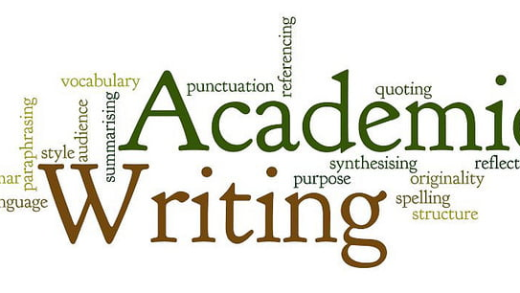
How much do you know about academic style? Go kahoot.it https://create.kahoot.it/share/how-much-do-you-know-about-academic-writing-style/72d0d372-eaf6-4263-bb8e-217fcb8cda76

Slide 19
Rules of academic writing
Formality
Objectivity
Precision
Tentative language
Explicit links
Conciseness

Slide 20
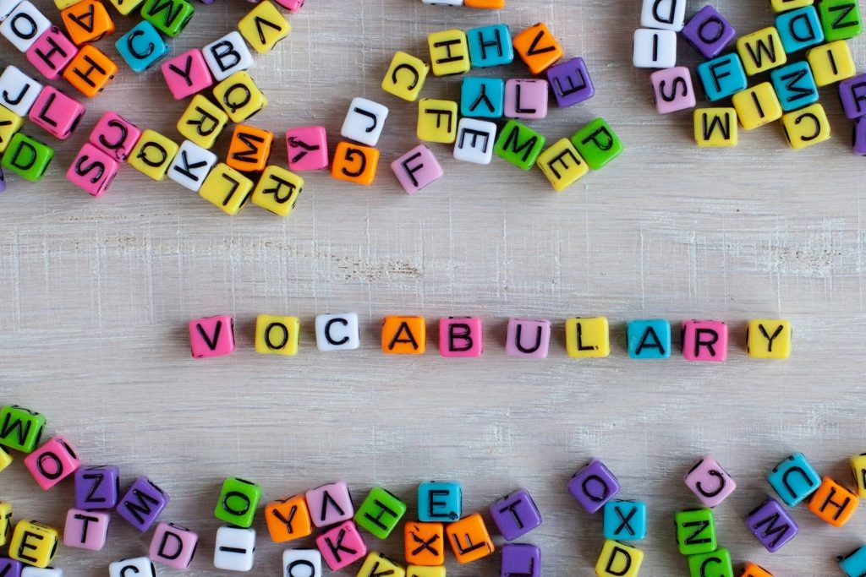
Formality
Use formal vocabulary, such as words from the academic wordlist (AWL).
Avoid less formal or idiomatic vocabulary.
✗ Many dads these days...
✓ Many fathers nowadays...
✗ Major urban centres, like London and Beijing...
✓ Major urban centres, such as London and Beijing...
✗ There are lots of people who believe...
✓ There are a significant number of people who believe...
✗ There are 3 main reasons for this.
✓ There are three main reasons for this.

Slide 21
Exercise 1 Which of the two alternatives in bold do you think is more appropriate in academic writing?
The government has made considerable/great progress in solving the problem.
We got/obtained excellent results in the experiment.
The results of lots of/numerous tests have been pretty good/encouraging.
A loss of jobs is one of the consequences/things that will happen if the process is automated.
The relationship between the management and workers is extremely/really important.
Some suggestions springing up from/arising from the study will be presented.

Slide 22
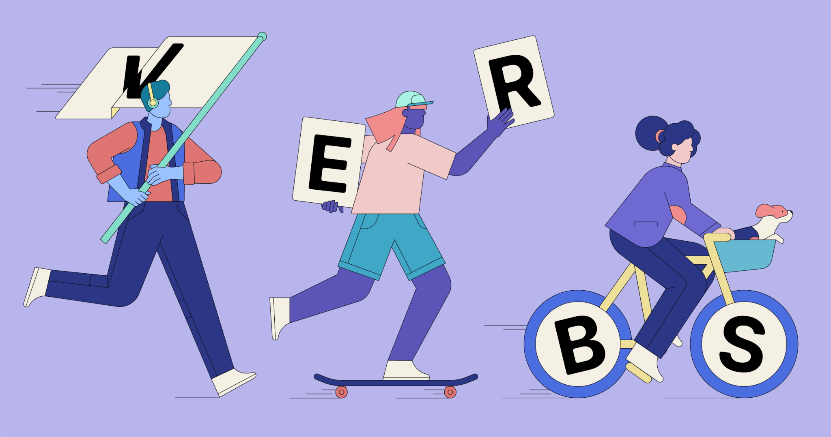
Formality
Use formal verbs instead of two-word verbs.
✗ go up, go down, talk about, get better, get worse, go on, bring up
✓ increase, decrease, discuss, improve, deteriorate, continue, raise
Use the full form of verbs, not contractions.
✗ don't, can't, won't, didn’t
✓ do not, cannot, will not, did not

Slide 23
Exercise 2 Replace the phrasal verbs in the sentences with a more appropriate verb from the list below. Don't forget to keep the same tense.
fluctuate | investigate | eliminate | raise | reduce | propose | intervene | establish
Researchers have been looking into the problem for 15 years.
This issue was brought up during the seminar.
It is assumed that the management knows what is happening and will therefore step in if there is a problem.
Schools cannot altogether get rid of the problem of truancy.
The number of staff has been cut down recently.
It was very difficult to find out exactly what happened.
House prices have a tendency to go up and down.
A potential solution was put forward two years ago.

Slide 24
Formality
Use formal grammar structures, such as nominalisation (noun phrase) and clauses, rather than too many simple sentences.
✗ The environment is increasingly polluted. This is a global concern.
✓ The increasing pollution of the environment is a global concern.
✗ Note-taking is an important skill for EAP students. It is difficult to master.
✓ Note-taking, which is an important skill for EAP students, is difficult to master.

Slide 25

Formality
Use statements. Avoid rhetorical questions, which are less formal (though these are common in spoken academic English, i.e. lectures and presentations).
✗ What were the reasons for the decline?
✓ There were four main reasons for the decline.
✗ How are written and spoken English different?
✓ Written English is different from spoken English.

Slide 26
Objectivity
Use impersonal language, such as 'There is...', 'It is...', or passive voice. Avoid personal pronouns (I, we, you, etc.) and adverbs which show your feeling (e.g. luckily, remarkably, amazingly).
✗I can think of three main problems.
✓There are three main problems.
✗ In the experiment, I heated the water...
✓ In the experiment, the water was heated...
✗ Amazingly there were very few errors in the experiment.
✓ There were very few errors in the experiment.

Slide 27
Exercise 3 Suggest alternatives to the following to avoid use of personal language.
In this essay I will discuss the main differences between the English and Scottish legal systems.
I have divided my report into five sections.
I will conclude by proposing that all drugs should be legalized.
The opinion of the present author in this essay is that the importance of the monarchy should be reduced.
In the third part of the essay, we will look at the reasons for public hysteria over the SARS virus.
Although I am not an expert in the field, I have tried very hard to understand the main ideas.

Slide 28
Suggested answers:
This essay will discuss
The report has been divided into five sections OR There are five sections in this report
The essay will conclude
The importance of the monarchy should be reduced because... (explain, with evidence)
The third part of the essay will examine / discuss / analyse... (choose the correct word to describe the content)
Remove this, just provide the evidence and your analysis

Slide 29
Exercise 4 Suggest improvements to the following sentences to avoid use of “you” and “we”.
You can apply the same theory of learning to small children.
You can only do this after the initial preparation has been conducted.
The figures are accurate to within 1%, but you should note that local variations may apply.
In the second section of the report, we will consider the environmental consequences.

Slide 30
Suggested answers:
The same theory of learning can be applied
This can only be done
it should be noted that
The second section of the report will

Slide 31
Precision
Be as precise as possible. Use exact figures or values wherever possible, rather than 'about' or 'several'. Use words such as 'factor', 'issue', 'topic', 'aspect' instead of vague words such as 'thing’.
✗ There are several reasons for this.
✓ There are three main reasons for this.
✗ The turning point was about 30 years ago.
✓ The turning point was in the late 1980s.
✗ There were three things which led to this result.
✓ There were three factors which led to this result.

Slide 32
Precision
Be sure to cite your sources. Avoid making vague claims.
✗ Everybody knows that most people are unaware of the problem.
✗ Most people are unaware of the problem.
✓ Russell (2001) states that over 50% of the population are unaware of the problem.

Slide 33
Tentative language
Use hedging (i.e. tentative language), such as 'possibly', 'probably', 'may', 'might', 'appears to', and 'seems to' to qualify statements. Avoid absolute statements and words such as 'always'.
✗ Education reduces crime.
✓ Education may reduce crime.
✓ It appears that education reduces crime.
✗ This is caused by the effects of global warming.
✓ This is possibly caused by the effects of global warming.
✓ This may be caused by the effects of global warming.
✗ ESL students always make mistakes with tenses.
✓ ESL students often make mistakes with tenses.

Slide 34
Exercise 5 Change these statements using tentative language
Today, everyone uses credit cards for all their shopping.
Drinking wine is bad for you.
Global warming will have disastrous consequences for the whole world.
Teleworking leads to isolation.
Women are worse drivers than men.

Slide 35
Explicit links
Use appropriate transition signals to make explicit (i.e. clear) links between ideas and to introduce new sections of an academic writing. Avoid numbering or bullet points (except in certain reports), and basic transitions to begin sentences (e.g. 'And', 'But', 'So'). Also be careful not to use too many transitions (not at the beginning of every sentence!).
✗ 2. Inflation.
✓ Turning to the question of inflation...
✗ And inflation is an important factor.
✓ In addition, inflation is an important factor.

Slide 36
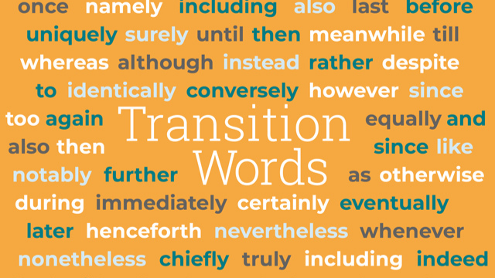

Slide 37
Conciseness
Concise writing means using the fewest words possible to convey an idea clearly.
Keep concrete, specific examples. Cut out extra words, empty phrases, weak qualifiers, negative constructions, and unnecessary “to be” verbs.
Wordy: The course had several necessary requirements.
Concise: The course had several requirements.
Wordy: She struggled to sit through his really boring speech.
Concise: She struggled to sit through his tedious speech.
Wordy: Frequently, a chapter in a book reveals to the reader the main point that the author desires to bring out during the course of the chapter.
Concise: A chapter’s title often reveals its thesis.

Slide 38

Features of academic writing (summary)
https://learningapps.org/display?v=pxr3kt4ut23

Slide 39
Practice Time!
Working with handouts

Slide 40
Reference
De Chazal, E., & Rogers, L. (2013). Oxford EAP. Intermediate/B1+. Oxford University Press
http://www.uefap.com/vocab/vocfram.htm

Slide 41
Any questions?
You can find me at:
s.seytniyazova@centralasian.uz
Office hours: by appointment
Office № 251

